Slide 1
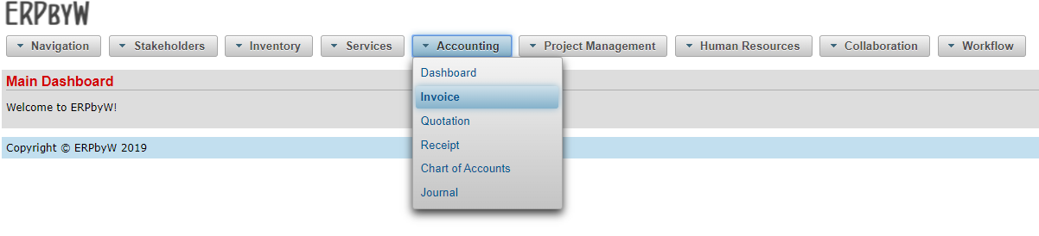
New Invoice Workflow

Slide 2
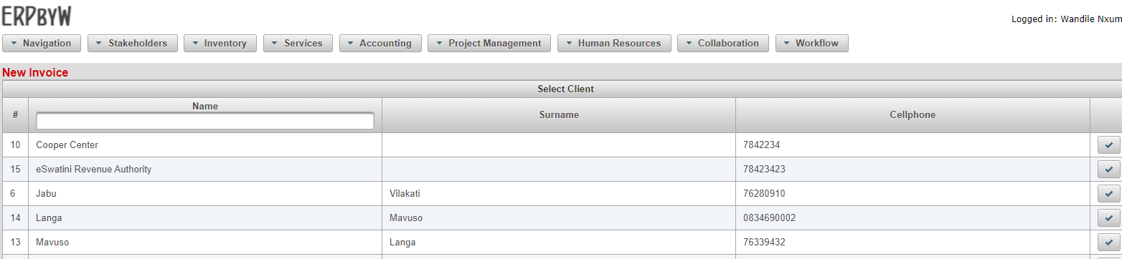
Select Stakeholder/Client

Slide 3
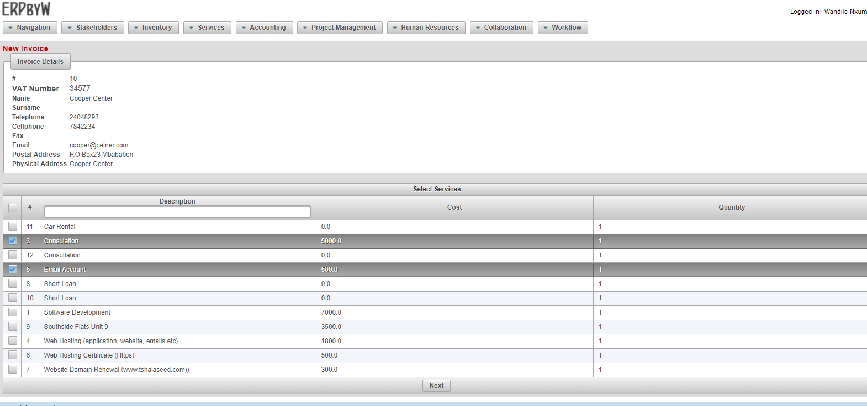
Add Services

Slide 4
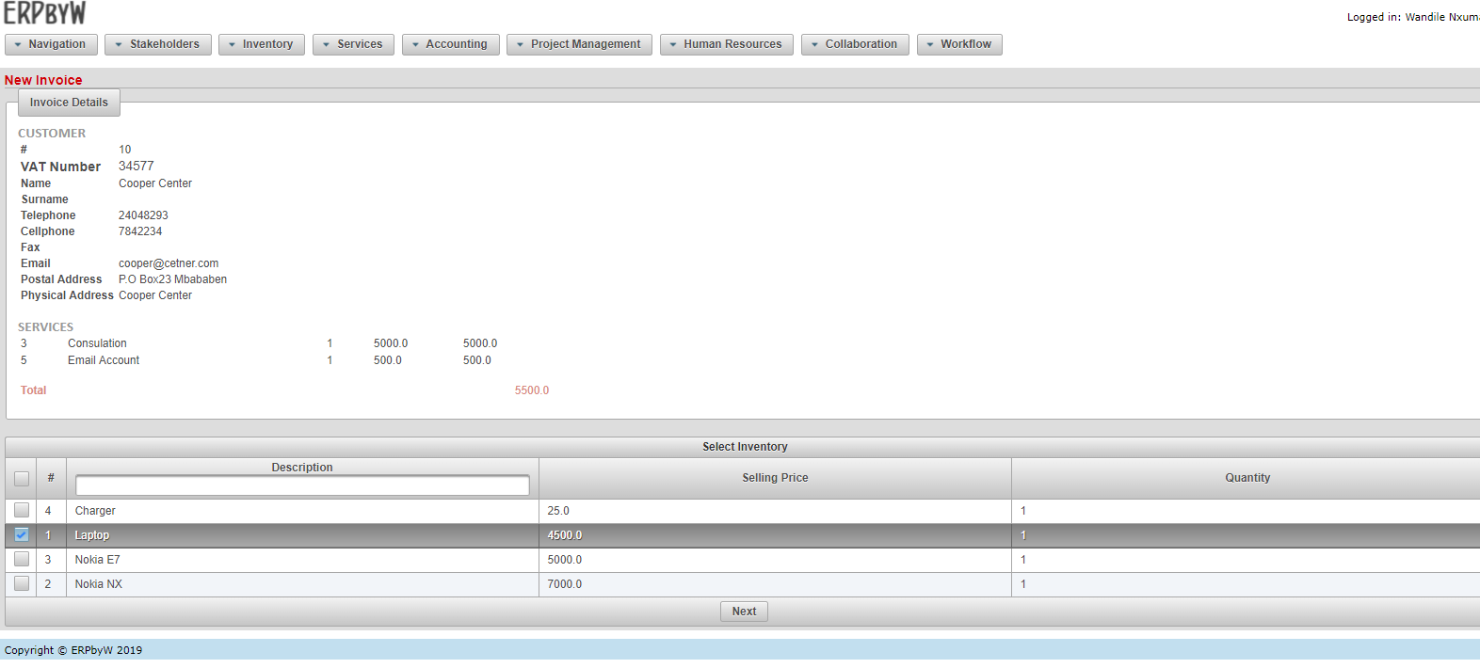
Add Inventory

Slide 5
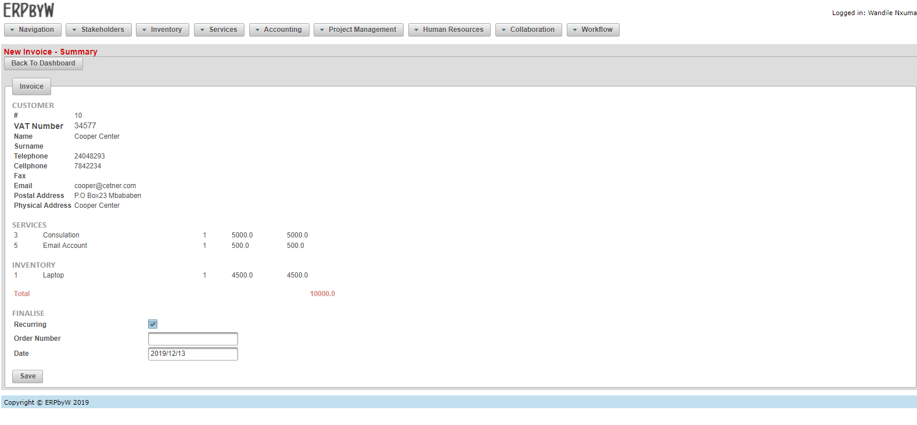
Set Recurring, Enter Order # and Date

Slide 6
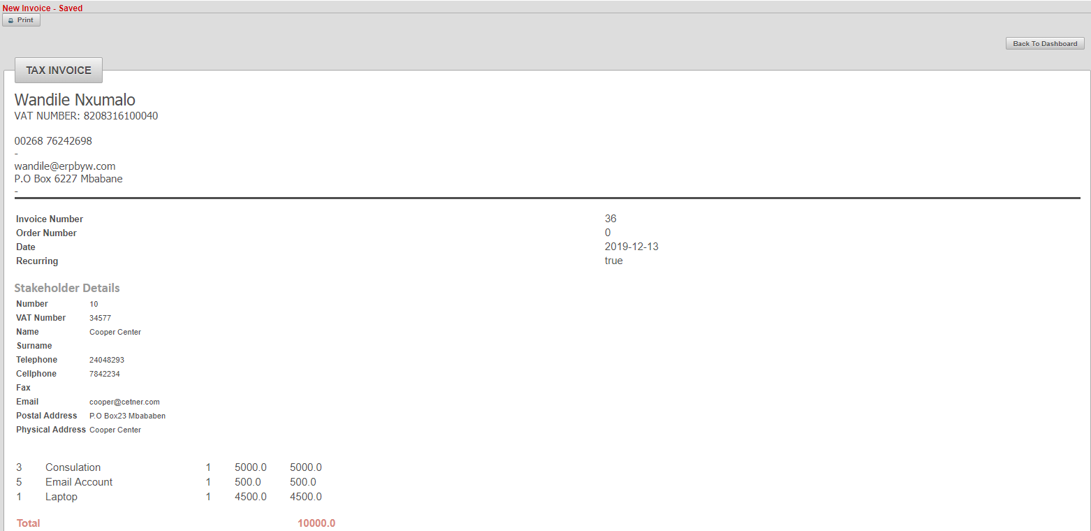
Preview and Print/Email Invoice

